Slide 1
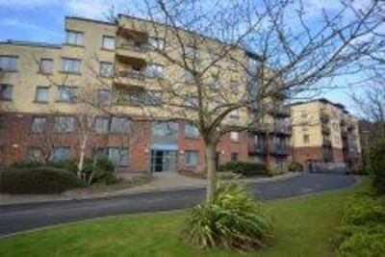
Tolka Vale Management Company CLG
AGM 1st September 2025

Slide 2
Agenda
Minutes of Previous Annual General Meeting *
Matters Arising
Annual Report *
Adoption of Auditors Report & Financial Statements for year ended 31/12/24. *
Resolution authorising the Directors to fix the remuneration of the Auditors. *
Motion to adopt Service Charge and Sinking Fund (Building Investment Fund) for 2025*
Election of Directors *
Any Other Business
* motions require a vote

Slide 3
Meeting Procedures
The function of the Annual General Meeting is to approve the audited accounts, pass the service charge budget and elect the Directors.
Please include your name (or unit number) on your profile so we can record attendees.
The agenda covers 8 agenda items some of which require voting. Voting will be provided for after the Board of Directors have presented their report.
Questions can be raised through the chat function or by raising your hand. There is a section for Q&A prior to proceeding to the vote.
Questions not relevant to the AGM will be reviewed by the Directors and replies issued to members as appropriate.

Slide 4
Minutes of AGM held 12 September 2023
Minutes of the Annual General Meeting of Tolka Vale Property Management Company CLG held on the 12^{th of} September 2023 via Zoom.
_________________________________________________________________________________________
In Attendance: The Board of Directors, comprising: John McCann, Carl Ryan, Denis Kavanagh, Damien Murphy, Anna Leslie, Niall Gormley, Clara Marley
Alan Drennan and Ciara Dunne – Managing Agent (Benchmark Property)
A full list of attendees is available from the registered office.
_________________________________________________________________________________________
Opening Address
The Managing Agent, Alan Drennan (the MA), opened the meeting and welcomed the attendees. The meeting proceeded and a presentation was shared with the attendees. As part of the presentation, opportunities for questions were provided and the queries were dealt with as they arose.
1. Minutes of Previous Annual General Meeting
The minutes of the previous AGM were taken as read and approved.
2. Annual Report
The MA read through the Annual Report. There being no queries the Annual Report was adopted by a show of hands.
3. Adoption of Auditors Report and Financial Statements for the year ended 31 December 2022
John McCann the finance director discussed the accounts, including income, expenditure and the debt position at length. The resolution to adopt the Auditors Report and Financial Statements for year ended 31 December 2022 was proposed by John McCann, seconded by Carl Ryan and adopted by a show of hands.
4. Resolution authorising the Directors to fix the remuneration of the Auditors
The resolution authorising the Directors to fix the remuneration of the Auditors was proposed by John McCann seconded by Carl Ryan and approved by a show of hands.
5. Approval of the service charge budget for the financial year commencing 1st January 2024
The MA discussed the budget, which had previously been circulated to the members. The MA advised that energy costs had driven increases in both energy supply and refuse charges. The proposed service charge budget was adopted by a show of hands.

Slide 5
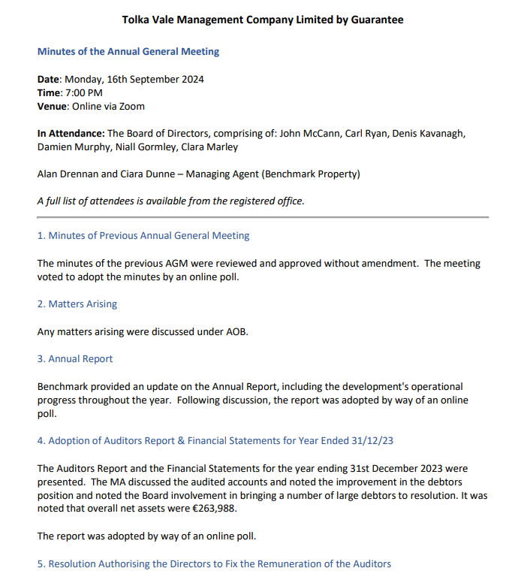
Minutes of AGM held 16 September 2024

Slide 6
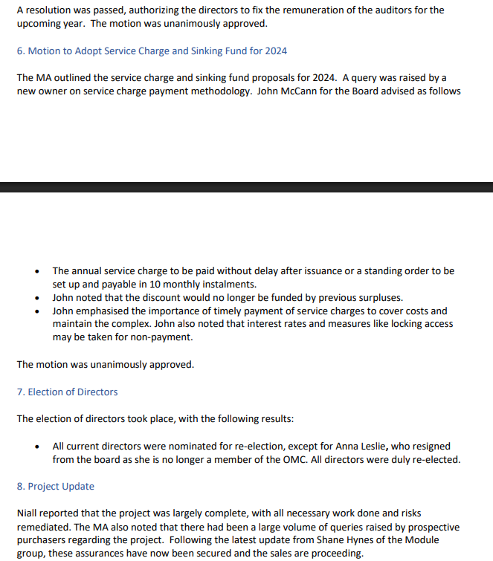
Minutes of AGM held 16 September 2024

Slide 7
Minutes of AGM held 16 September 2024

Slide 8
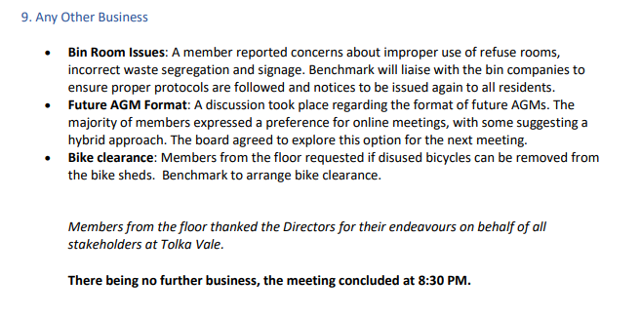
Minutes of AGM held 16 September 2024

Slide 9
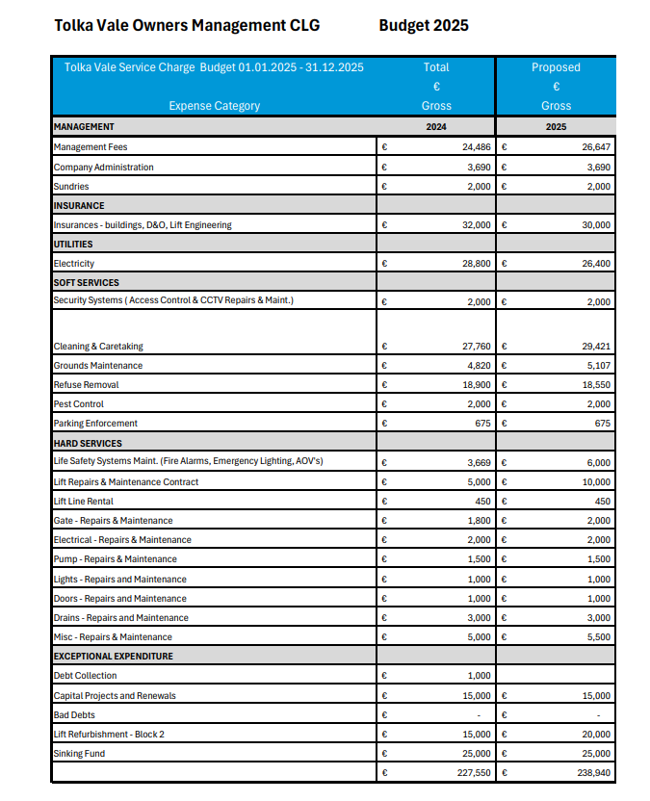
Budget 01.01.25 to 31.12.25

Slide 10
Annual Report
Contents:
A Statement of Income & Expenditure as per Auditors report for year ended 31st December 2024 is detailed in the Audited Accounts. (Please refer to page 11 of the Audited Accounts).
A Statement of Assets & Liabilities as per Auditors report for year ended 31st December 2024 is detailed in the Audited Accounts. Please refer to page 12 of the Audited Accounts.
A statement on the Annual Sinking Fund and the basis of which such contribution is calculated.
A statement of any planned expenditure on the refurbishment, improvement or maintenance of a non-recurring nature intended to be carried out in the period.
A statement of the insured value of the development, the premium charged, the name of the insurance company and a summary of the principal risks covered.
A statement of the fire safety equipment installed in the development and arrangement for maintenance of same.
A statement fully disclosing any contracts entered into between the OMC and a director of the company.
3. The Annual Sinking Fund
A sinking fund is a reserve created to build up sums which can be used to pay for large items of cyclical expenditure such as the refurbishment of a roof and for major items which arise regularly such as redecoration of the common area interiors. The sums required can be significant over a 20-to-30-year life cycle. The fund should be initiated from the very first year and then adjusted as necessary annually and collected to avoid, as the work arises, the costs having to be funded through a special levy or a one-off lump sum.
The MUD Act 2011 requires the Owners Management Company to establish a sinking fund for the refurbishment, improvement or maintenance of non-recurring expenditure i.e. Re-carpeting, exterior painting or lift replacements. Each owner currently contributes to the fund.
The proposed contribution to the sinking fund for Tolka Vale Management CLG for approval at the upcoming meeting as set out in the budget is €25,000

Slide 11
Annual Report
4. Planned Expenditure on Refurbishment
There is a planned expenditure of €10,000 to refurbish the lift in Block 2.
5. The Insurance Premiums
Block Insurance
The development’s Block Insurance Policy is currently underwritten by Swiss RE. The Insurance brokers are You and Us. The Insurance is annually reviewed and renewed having consideration for the adequacy of existing policy sums insured, limits of indemnity, scopes of cover, interested parties etc.
The annual Insurance premium for year ending 2024 is €23401.
Please note that there is a Policy Excess applicable of €3,000 for water damage claims.
Principle Risks Covered by the block policy:
Buildings
Contents of the common areas
Loss of metered utility Supplies
Replacement of locks and keys
Landscaping
Fire Brigade Charges
Trace & Access

Slide 12
Annual Report
Alternative Accommodation (36-month indemnity period) 20% of buildings sum insured
D&O Policy
There is also a Directors and Officers policy in place to cover the Directors for any act or omissions in performing their duty as Company Directors of.
Engineering Policy
There is also an engineering policy in place to cover the passenger lifts at the development.
6. Fire Safety Statement
The following are the fire safety systems in Tolka Vale and are maintained in accordance with the required legislation:
Fire Alarms Tee Fire Safety Solutions
Emergency Lighting Tee Fire Safety Solutions
Fire Extinguishers & Extinguishers Tee Fire Safety Solutions
The fire extinguishers and dry risers are maintained and serviced by Tee Fire Safety Solutions.
7. Conflicts of Interests
There are currently no contracts between the Owners Management Company & Directors of the Owners Management Company.

Slide 13
Annual Report
Alternative Accommodation (36-month indemnity period) 20% of buildings sum insured
D&O Policy
There is also a Directors and Officers policy in place to cover the Directors for any act or omissions in performing their duty as Company Directors of.
Engineering Policy
There is also an engineering policy in place to cover the passenger lifts at the development.
6. Fire Safety Statement
The following are the fire safety systems in Tolka Vale and are maintained in accordance with the required legislation:
Fire Alarms Tee Fire Safety Solutions
Emergency Lighting Tee Fire Safety Solutions
Fire Extinguishers & Extinguishers Tee Fire Safety Solutions
The fire extinguishers and dry risers are maintained and serviced by Tee Fire Safety Solutions.
7. Conflicts of Interests
There are currently no contracts between the Owners Management Company & Directors of the Owners Management Company.

Slide 14
Report from Directors
Leaks:
Unfortunately a number of water system leaks occurred during the year. The main cause of these leaks have been plumbing failures. As the development ages the likelihood of similar leaks occurring will increase. AS such, it is imperative that all owners maintain their apartments and carry out upgrades and repairs on a routine basis.
Under the legal title, there is a responsibility on owners to ensure that their apartments are maintained in first class order and it is imperative that the enclosed checklist is completed. Please note that any owner who does not facilitate the inspection may not be in a position to make an insurance claim should any damage arise and, importantly, could be joined to an ongoing legal action. Please do also be conscious that any water leaks are likely to affect neighbouring and adjoining apartments and ass such it is in everyone’s interests that the checklist is completed.

Slide 15
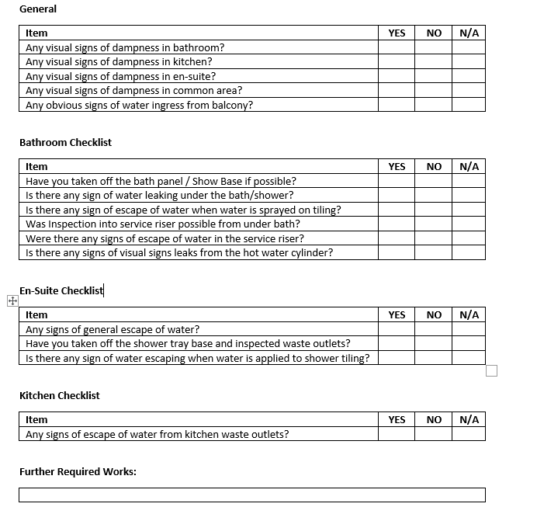
Report from Directors

Slide 16
Voting
Please vote Yes or No on each of the polling items.

Slide 17
Tolka Vale Management CLG
Any Other Business?

Slide 18
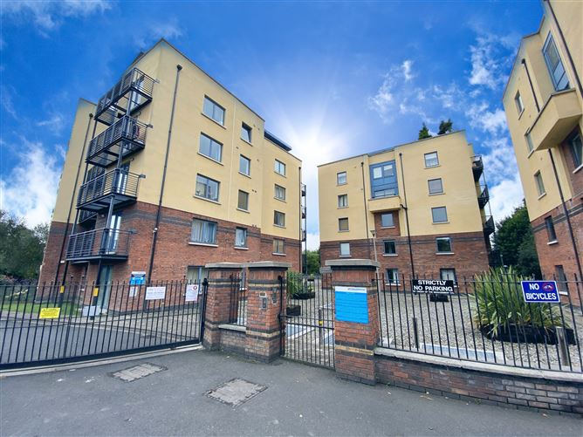
Thank you

